Slide 1

Housing Model Project
Submitted By: Nihal R. Singh

Slide 2
Introduction:
The project is Housing Pricing prediction model is basically use to predict the predict the price of the house based on different criteria.
US Based Housing company Surprise Housing has used data analysis to purchase the houses at lower price of their actual value and sell them to a higher price in Australia..
Housing Pricing prediction model is used to predict the probability of the price for the house to buy and then sell them to higher price.
The model is build by working on multiple models and finalizing the one best model after working on data.
For building the model performing data cleaning, EDA, data preprocessing, model building, hyper parameter tuning and saving the model.

Slide 3
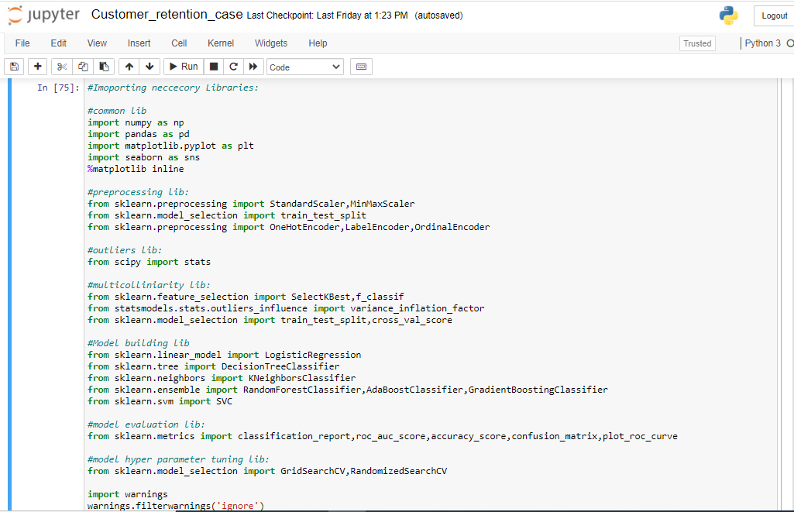
Importing Libraries:
Importing the Libraries used for EDA, data preprocessing and model building.

Slide 4
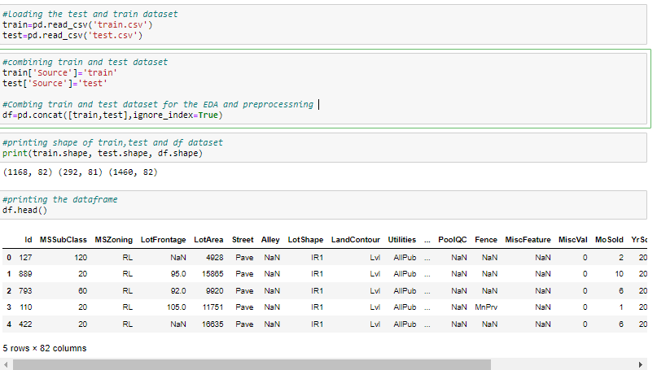
Fetching the Data frame:
Using the pandas library to import the data from csv file to data frame.
The library has been used read_csv.
There are two csv file train and test so merging both the file for data preprocessing and perform the EDA.

Slide 5
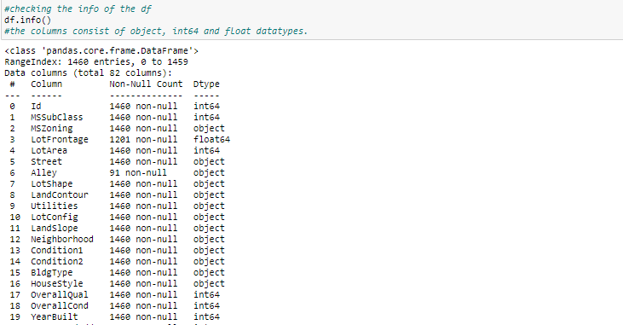
Checking the Shape and info of Data Frame:
Checking the shape of the Data frame using the .shape method.
The shape of the train data frame is (1168,82), test data frame is (292,81) and combined data frame is (1469,82).
Checking the datatype information about the data frame using the info method.

Slide 6
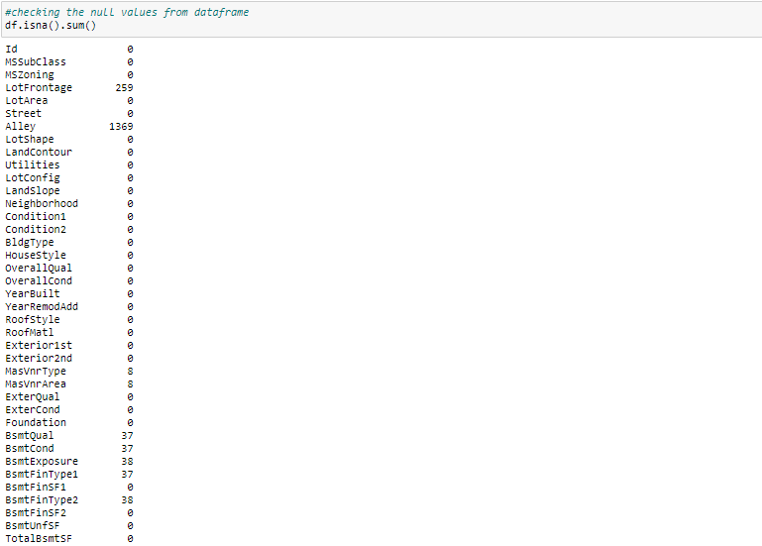
Checking the Null value count in Data frame:
Checking the null value count from every column of data frame.
Using the isnull().sum() method to check the null values. There is no null values in columns.

Slide 7
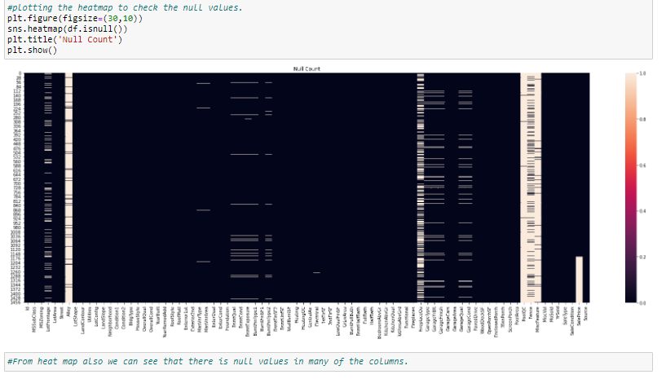
Checking the Null value using Heat map:
Checking the null value count from every column of data frame using the heat map.
Using the seaborn library and using the heat map from the library. There is no null values present in the given data frame.

Slide 8
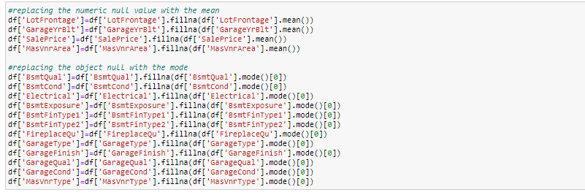
Filling the Null value count in Data frame:
After checking null value fill the null value with the mean and mode..
Using mean to fill the null value of numerical data and using mode to fill null value of the categorical data.

Slide 9
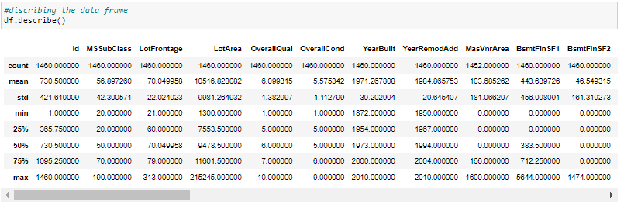
Using Describe Method to describe the data frame:
Using the describe method to describe the numerical columns.Describe method
only work on the numerical data features.
Describe is basically provide the count,mean,standered deviation,min max and quantile details of the columns data.it can be display using df.describe().

Slide 10
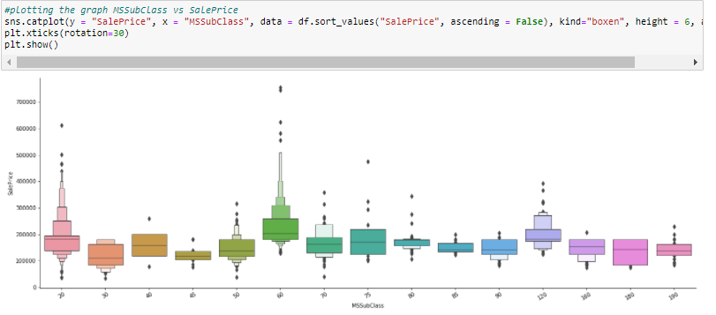
Plotting the Cat Plot:
Using the Cat plot to plot the graph for MSSubclass featues vs Saleprice target.
The Cat plot shows the sale price based on the MSSubclass featues .

Slide 11
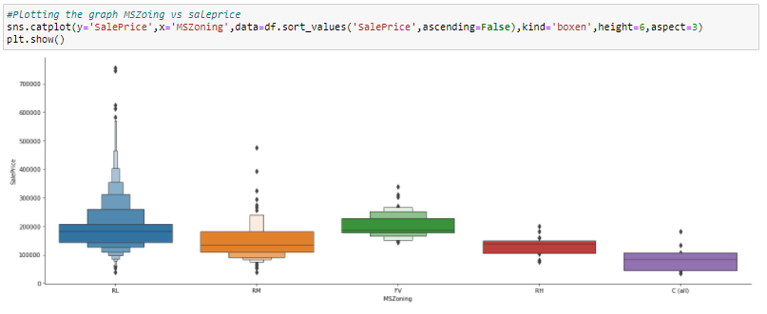
Plotting the Cat Plot:
Using the Cat plot to plot the graph for MSZoing features vs Saleprice target.
The Cat plot shows the sale price based on the MSZoing features .

Slide 12

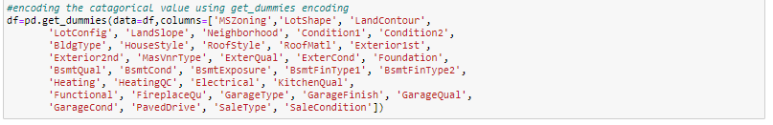
Using the Encoder to encode the categorical data:
The features having only two values can be encoded using Label Encoder.
For more than 2 values use get_dummies to encode the categorical data to numerical data.

Slide 13
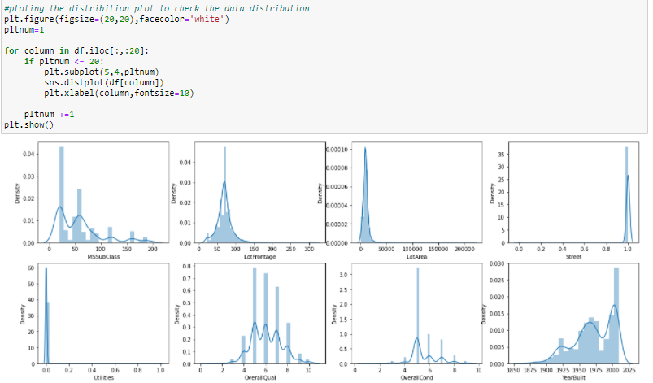
Plotting the Distribution Plot:
After performing the data cleaning and describe the data plotting the dist plot to check the data distribution.
From the dist plot it is observed that there is outliers are available at all the features.

Slide 14
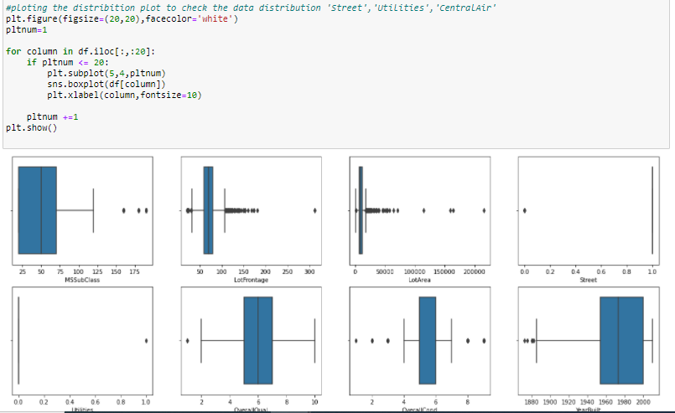
Plotting the Box Plot:
Using box plot to check the outliers in the features of the dataframe.outliers can be easily visible by using the box plot.
The Black dotted lines are the outliers present in the features.

Slide 15
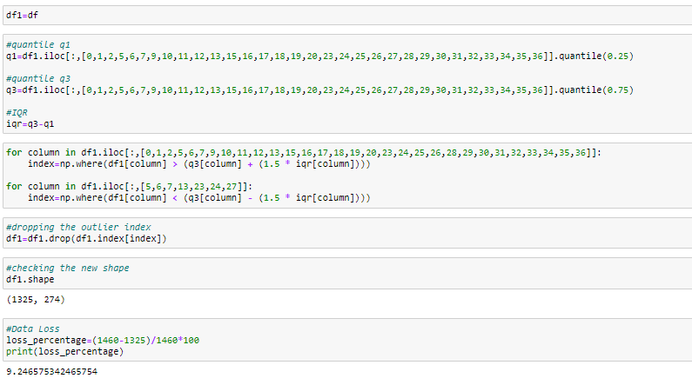
Removing Outliers using IQR:
There are multiple option to check the outliers and then delete the outliers.
The most commonly used method is z-score, IQR and quantile method. For this model using the IQR method.
The 9.34% data has loss after removing the outliers from the data frame.

Slide 16
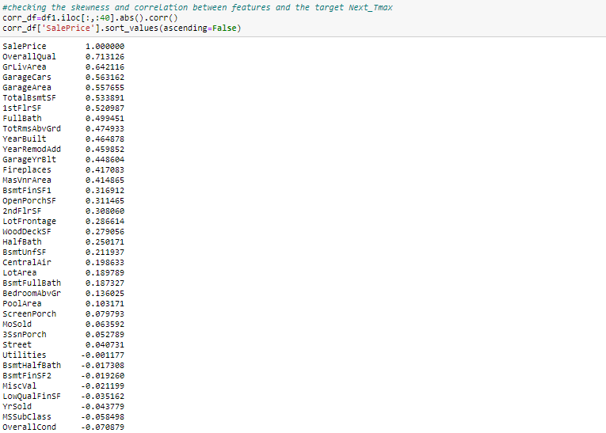
Skewness Removal:
After removal of the outliers, skewness is very important to check and if skewness is present then removal of the skewness.
Max times removal to outliers is automatically remove the skewness in the data.
The range of the skewness is -0.5 to +0.5,if the values are between that then there is no skewness available. Here we can see some skewness in the features.

Slide 17
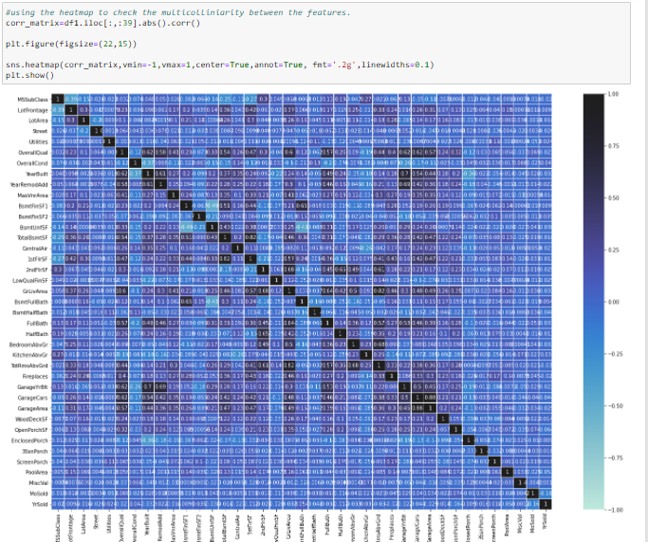
Checking Multicolliniarity Using Heat map:
Multicolliniarity is a problem for a model building.it shows relation between feature to feature. If the score is high then the features are highly collinear to each other.
Checking the multicolliniarity problem using heat map.

Slide 18
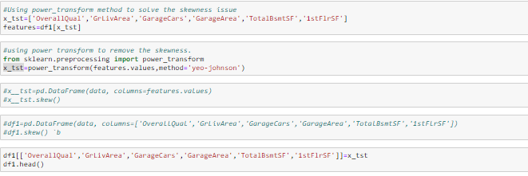
Removing Skewness using the Power Transform:
Power Transform function is used to remove the skewness from the features.
Applying power transform on only those features which having the skewness issue means the range is not between the -0.5 and +0.5 .

Slide 19
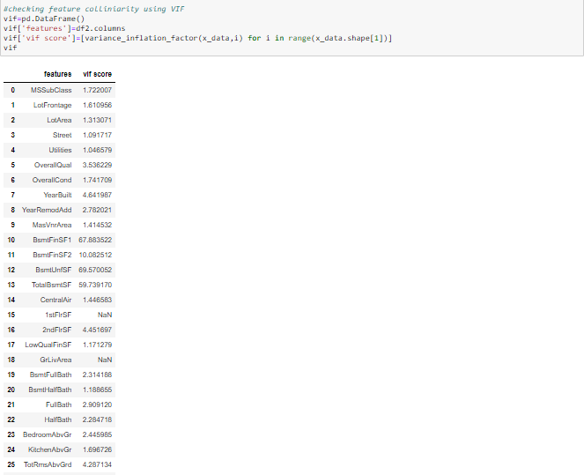
Checking Multicolliniarity Using VIF:
Checking the multicolliniarity issue with the help of variance inflection factor as we can see there is multicolliniarity issue using the heat map.
VIF provide the VIF score, if the score is greater than 5 then there is issue of multicolliniarity.

Slide 20
Removing column having multicolliniarity issue and Scaling the features:
Removing the columns from the data frame having multicolliniarity issue getting from the vif score.
Scaling the data after removing the features form vif score. Scaling is most important part in model building as after scaling data came to the same range.
Using the standard scalar to scale the data.

Slide 21

Separating the Train and Test Data:
Separating the train and the test data after performing the data preprocessing and EDA on the both the data set.
Now separating the train and test data set to perform model building on the train data sets.
The Model Building is only done on the train data frame and test data set is used to predict the model accuracy.

Slide 22
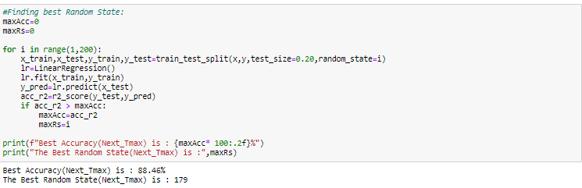
Training the model and finding the best random state:
After the EDA and data preprocessing training the model and finding the best random state using the train test split.
The training the model into x_train, y_train, x_test and y_test.

Slide 23
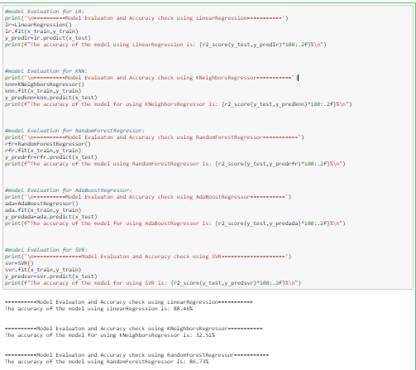
Building the multiple Models:
After the test_train_split, building the model using the test data.
Building all the classification models like Linear Regression , KNeighborsRegressor, AdaBoostRegressor, RandomForestRegressor, SVR.
Training all the classification on train and test data and finding the r2_score.

Slide 24
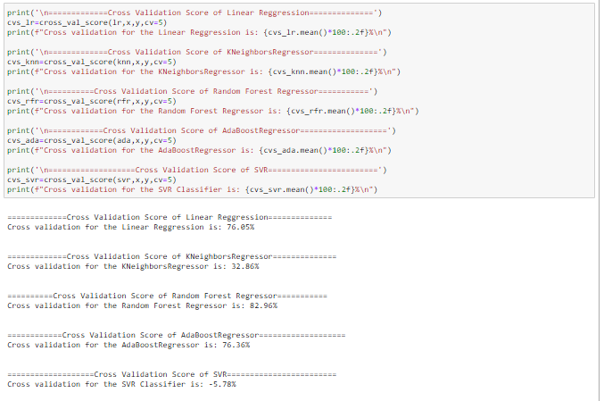
Performing Cross validation score:
After building the multiple models and getting the accuracy performing the cross validation score on all the models.
Cross validation is basically used to check the model is under fitting or over fitting on the test data.

Slide 25
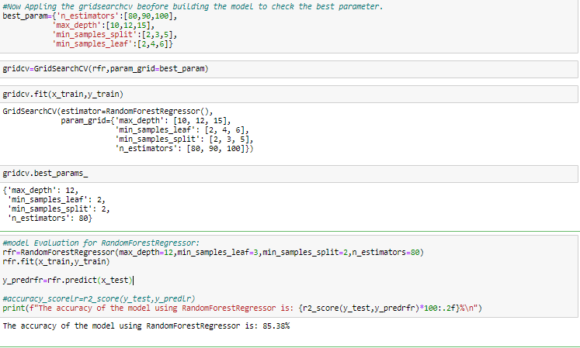
Hyper Parameter Tuning:
Selecting Random forest Regressor as a best model as it has highest score and least difference between r2_score and cross validation score.
Hyper parameter tuning having multiple parameters and selecting the best parameter for the model.

Slide 26
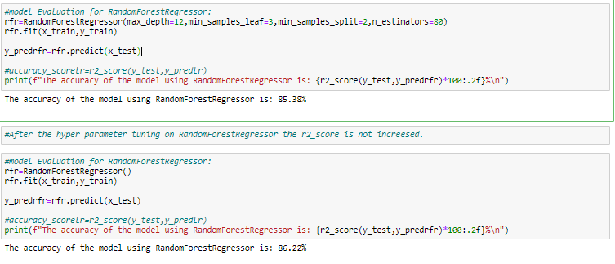
Training the model after Hyper parameter tuning:
Training the model again after the hyper parameter tuning and providing the best parameter values to the model gets from the hyper parameter tuning.

Slide 27

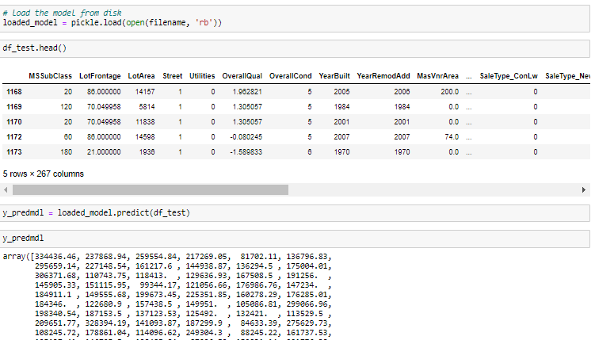
Saving the Model:
After the hyper parameter tuning saving the final model in the pkl file.
Now Loading the model to done price prediction on the test data frame.
This complete the model building.

